Slide 1
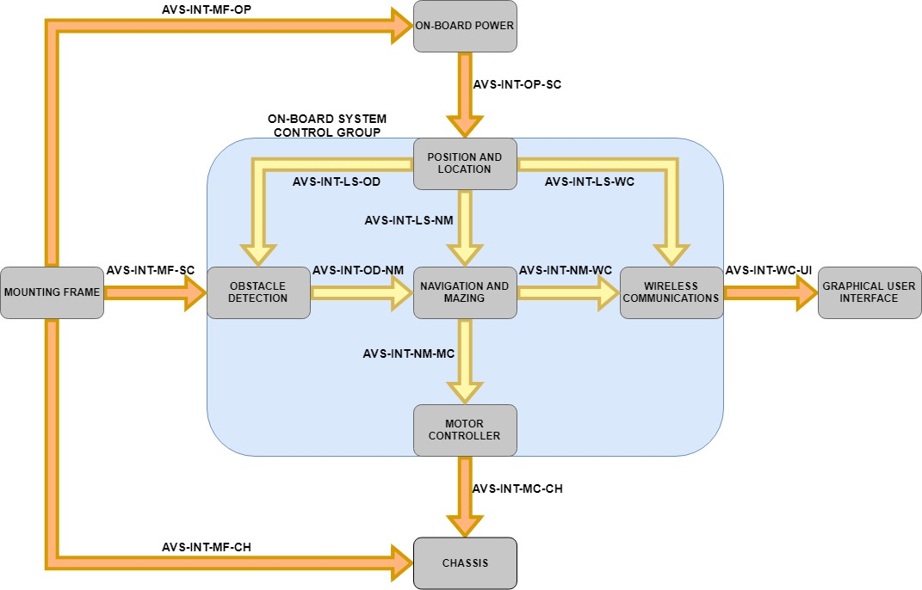
Obstacle Detection System – Context
Notes:
I’ll be briefly talking about the Obstacle Detection System, which is highlighted on the Context Diagram

Slide 2
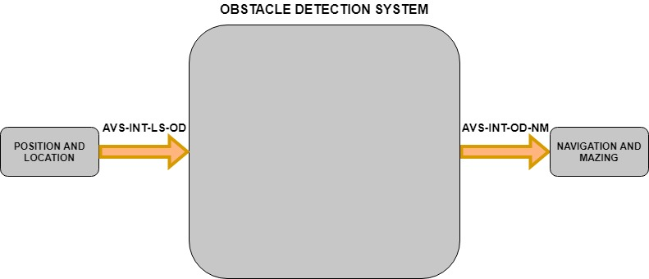
Obstacle Detection System – Black box
Purpose: To detect and locate obstacles to allow for more informed navigation decisions, in order to avoid obstacles.
Functions:
Detect obstacles within the range constraints of the HC-SR04 sensors (2cm – 400cm)
Output the grid reference location of detected obstacles to the navigation system
Notes:
The Purpose of the Obstacle Detection System is “To detect and locate obstacles to allow for more informed navigation decisions, in order to avoid obstacles.”
It will do this by detecting obstacles with the HC-SR04 Ultrasonic sensors, and outputting the grid reference of the detected obstacle to the Navigation and Mazing System.
As can be seen it will have:
one input interface (i.e. the position and location system)
and one output interface (i.e. the navigation and mazing system)

Slide 3
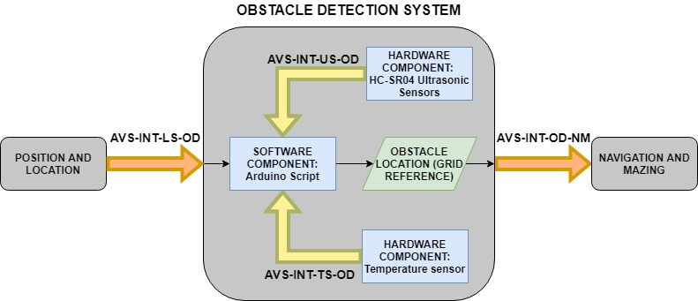
Obstacle Detection System - Internal
*if required*
Notes:
Internally it will require up to three major interfacing components:
The Ultrasonic sensors
If required a temperature sensor (to be discussed further later)
And the Arduino Script that will combine all the inputs and convert this into a grid reference to be outputted to the navigation system.

Slide 4
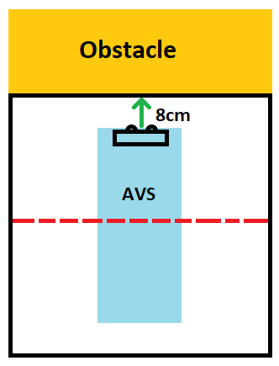
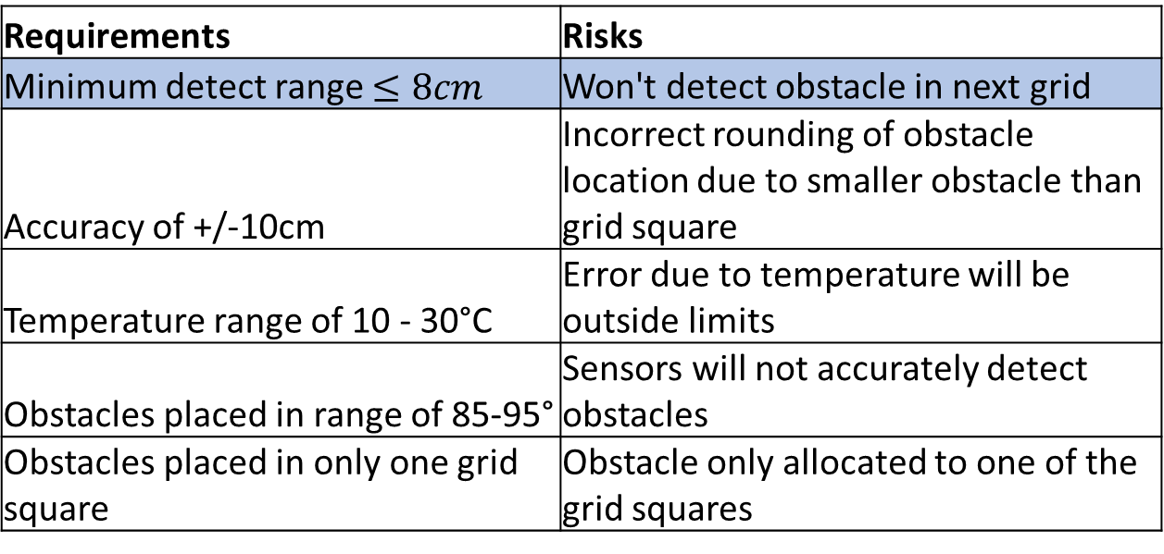
Obstacle Detection System - Risks
Requirements | Risks
Minimum detect range $≤8cm$ | Won't detect obstacle in next grid
Accuracy of +/-10cm | Incorrect rounding of obstacle location due to smaller obstacle than grid square
Temperature range of 10 - 30°C | Error due to temperature will be outside limits
Obstacles placed in range of 85-95° | Sensors will not accurately detect obstacles
Obstacles placed in only one grid square | Obstacle only allocated to one of the grid squares
Mitigation
Have minimum offset from vehicle as possible
Notes:
There are five major requirements and risk factors:
The system shall detect obstacles at a minimum range of $≤8cm$ (based on the geometry of the RC chassis).
Otherwise the system may not detect an obstacle in the adjacent grid as can be seen in the image.
Mitigation is to have as small an offset from the chassis as possible.

Slide 5
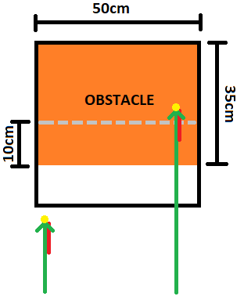
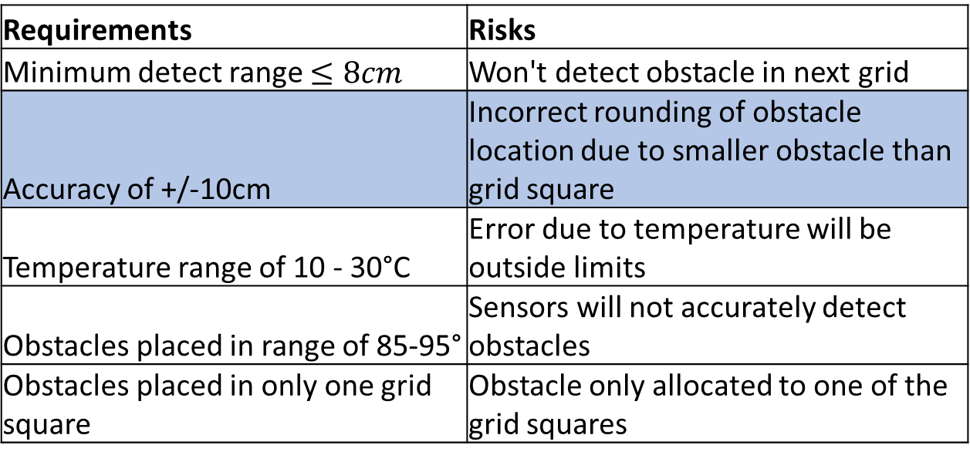
Obstacle Detection System - Risks
Requirements | Risks
Minimum detect range $≤8cm$ | Won't detect obstacle in next grid
Accuracy of +/-10cm | Incorrect rounding of obstacle location due to smaller obstacle than grid square
Temperature range of 10 - 30°C | Error due to temperature will be outside limits
Obstacles placed in range of 85-95° | Sensors will not accurately detect obstacles
Obstacles placed in only one grid square | Obstacle only allocated to one of the grid squares
Mitigation
Add negative distance bias such that rounding will be correct
Notes:
2. The system shall detect obstacles with an accuracy of at least $±10cm.$
Otherwise based on the difference in the sizes of the obstacles and the grid references rounding will incorrectly allocate obstacle locations.
Mitigation as seen in the diagram, is to if required, add a negative distance bias (shown by the red line) to correct rounding issues.

Slide 6
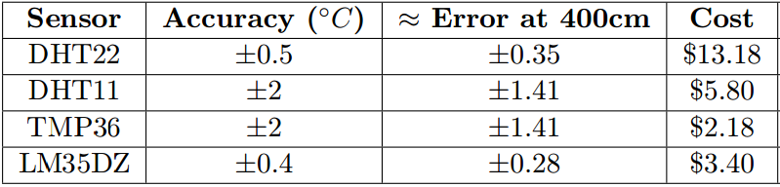
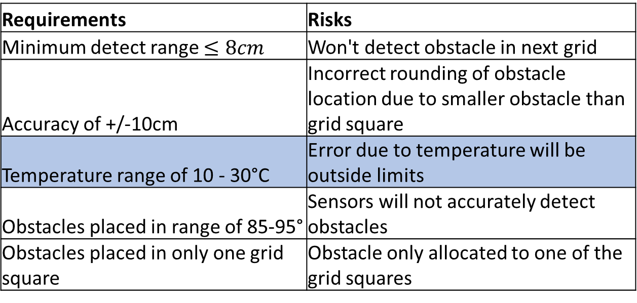
Obstacle Detection System - Risks
Requirements | Risks
Minimum detect range $≤8cm$ | Won't detect obstacle in next grid
Accuracy of +/-10cm | Incorrect rounding of obstacle location due to smaller obstacle than grid square
Temperature range of 10 - 30°C | Error due to temperature will be outside limits
Obstacles placed in range of 85-95° | Sensors will not accurately detect obstacles
Obstacles placed in only one grid square | Obstacle only allocated to one of the grid squares
Mitigation
Implement a temperature sensor if required
Notes:
3. Since the speed of sound in air varies with temperature, the system shall operate in a temperature range of $10−{30}^{o}C$.
Otherwise the error in the speed of sound will cause a distance error exceeding $±7cm$.
It has been determined that this range is reasonable, however if a higher degree of accuracy is needed a temperature sensor will be implemented. As can be seen in the table the sensors were compared based on the cost to error at max range benefit, and from this comparison a contingency component has been selected.

Slide 7
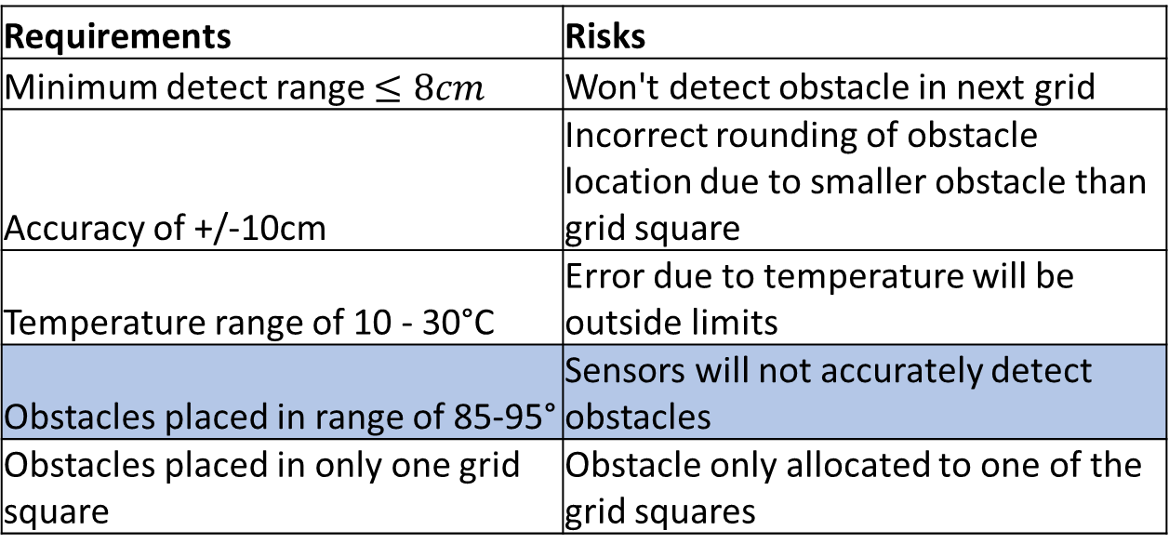
Obstacle Detection System - Risks
Requirements | Risks
Minimum detect range $≤8cm$ | Won't detect obstacle in next grid
Accuracy of +/-10cm | Incorrect rounding of obstacle location due to smaller obstacle than grid square
Temperature range of 10 - 30°C | Error due to temperature will be outside limits
Obstacles placed in range of 85-95° | Sensors will not accurately detect obstacles
Obstacles placed in only one grid square | Obstacle only allocated to one of the grid squares
Mitigation
Confirm with stakeholder if genuine risk, if so introduce a sweeping technique
Notes:
4. The obstacles are expected to be in a range of $85−{95}^{o}$ relative to the grid as the sensors require a near perpendicular surface to operate.
If not, the sensors will not accurately and consistently detect the correct distance of the obstacles.
If it is confirmed by the stakeholder that this is a genuine risk, a sweeping technique will be introduced to maximise chance of getting perpendicular surface.

Slide 8
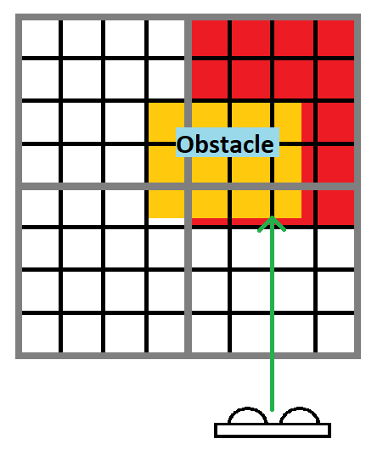
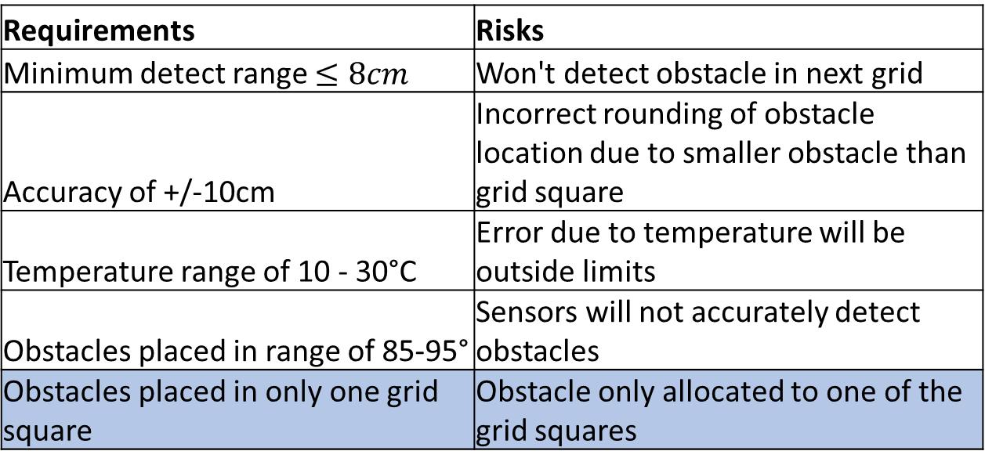
Obstacle Detection System - Risks
Requirements | Risks
Minimum detect range $≤8cm$ | Won't detect obstacle in next grid
Accuracy of +/-10cm | Incorrect rounding of obstacle location due to smaller obstacle than grid square
Temperature range of 10 - 30°C | Error due to temperature will be outside limits
Obstacles placed in range of 85-95° | Sensors will not accurately detect obstacles
Obstacles placed in only one grid square | Obstacle only allocated to one of the grid squares
Mitigation
Confirm with stakeholder if genuine risk, if so implement smaller detection grid-squares for higher resolution
Notes:
5. The obstacles are expected to be placed in only one grid space and not “leak” into surrounding grids as shown in the figure.
If not the system will incorrectly only allocate the obstacle to one of the grid squares.
If it is confirmed by the stakeholder that this is a genuine risk, each grid square will be broken up into smaller segments to allow for a higher resolution for obstacle location allocation as shown in the figure.

